Slide 1
DASAR TELEKOMUNIKASI
Konsep Dasar 2G, 3G, dan 4G
Syarifah Muthia Putri, ST., MT

Slide 2
Circuit Switching vs. Packet Switching
Circuit Switching
  Mostly used in the voice call.
  Whenever a call is being made, a dedicated logical link needs to be established.
  Network resource is allocated and reserved for the subscriber for entire duration of the call.
Packet Switching
  Mostly used in the Packet Data Connection.. . e.g. internet browsing
  Whenever an MS sends or receives data, data is organized into packet and each packet has source / destination ID.

Slide 3
Core Network : GSM
The core network in GSM is basically the circuit core.
In GPRS, EDGE and UMTS, it has two components, the circuit core and the packet core, which are responsible for voice and data respectively.
In GSM, core or circuit-core network planning is also known as switch planning, because it is mainly related to the mobile switching centre (MSC), also called 'Switch'.
Core network planning in GSM consists of network elements such as MSC, VLR, HLR, AC and EIR.

Slide 4
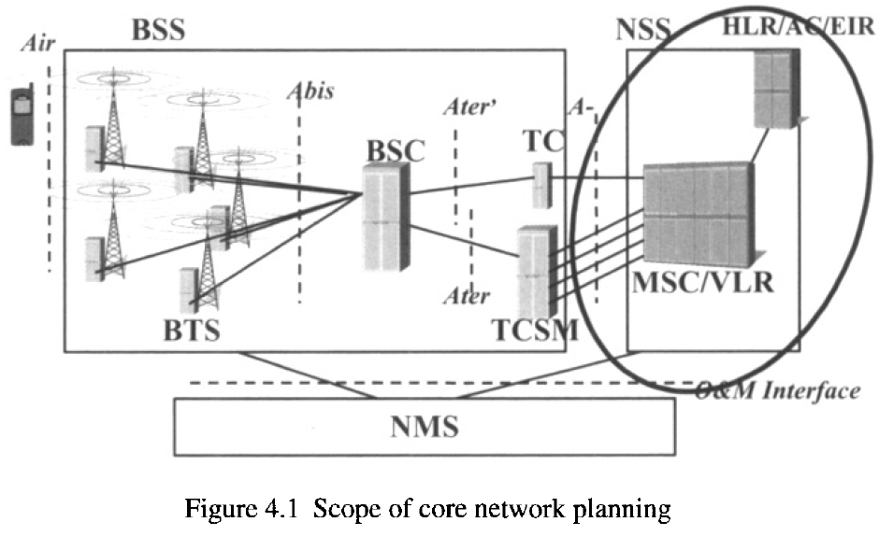
Core Network Planning : GSM

Slide 5
Core Network : 3G
Core network planning of a third-generation (WCDMA) system consists of both circuit core and packet core planning.
The scope of core network planning includes dimensioning of network elements such as MOW, MSC (and VLR) and HLR (and AC/EIR) from the CS side, while the PS core will include SGSN, GGSN along with interfaces.

Slide 6
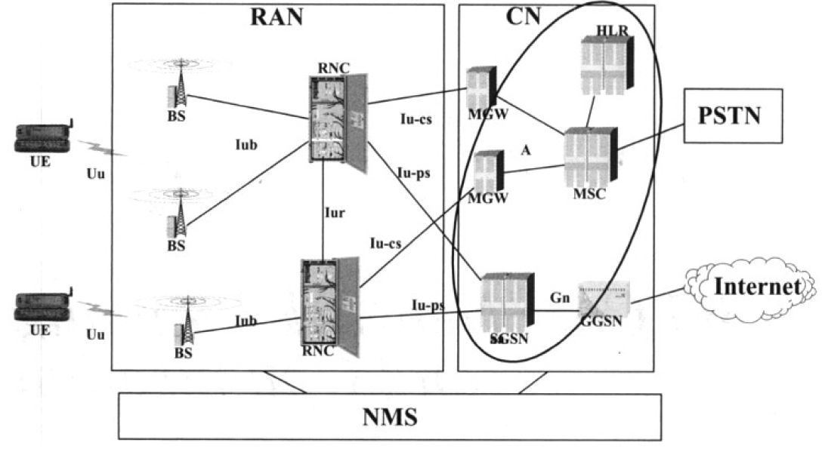
Core Network : 3G

Slide 7


2G and 3G Network Architecture
Circuit Core Domain
Nc
MSS/VLR
MSS/VLR
MS
BTS
Mc
Mc
MGW
Nb
MGW
PSTN
Other PLMN
Abis
BSC
A
SMSC
RADIUS
Charging Centre
IuCS
HLR
DNS
NMS / OSS
RNC
PCRF
DHCP
Gb
Service & subscriber management
MS
Iub
IuPS
Gz/Gs/Gr/Gf/Gd
Packet Data Network
e..g Internet
Gx/Gz
NodeB
Gi
SGSN
Gn
GGSN
Packet Core Domain
Control plane
User plane

Slide 8
Acronym in 2G / 3G
MS | Mobile Subscriber | A mobile phone with SIM card
BTS | Base Transceiver Station | Air interface toward MS in 2G
BSC | Base Station Controller | Controlling BTS
NodeB | n/a | Air interface toward MS in 3G
RNC | Radio Network Controller | Controlling NodeB
MSS | Mobile Switching Server | Mobility Management for CS Domain
VLR | Visitor Location Register | Manage temporary subscriber information within an MSS
HLR | Home Location Register | Manage permanent subscriber Database
MGW | Media Gateway | Manage user plane traffic
SGSN | Support GPRS Service Node | Mobility Management for PS Domain
GGSN | Gateway GPRS Service Node | Session Management , IP address allocation, QoS enforcement, Routing toward internet.

Slide 9
A Simplified 2G/3G PS Call Flow…(1/3)
Reference :
TS 23.060
TS 24.008
TS 29.060
1
Attach request..
Herewith the info
3
HLR
Gn DNS
MS
BTS / Nodeb
Abis / Iub
I am attached to the network and want to browse, by activating PDP context
Packet Data Network
e..g Internet
5
BSC
RNC
Get info for this subscriber
2
Gb IuPS
Gn
SGSN
GGSN
Attach accepted..
4
Internet DNS
Note :
  All procedures here are simplified for overview only. Reader should refer to above reference for detail procedures.

Slide 10
A Simplified 2G/3G PS Call Flow…(2/3)
Reference :
TS 23.060
TS 24.008
TS 29.060
Herewith the IP address of GGSN
7
HLR
Gn DNS
MS
BTS / Nodeb
Abis - Iub
I am attached to the network and want to browse , by activating PDP context
Packet Data Network
e..g Internet
5
BSC
RNC
Gb -IuPS
SGSN
Gn
GGSN
Gi
8
9
Internet DNS
11
6
Create PDP Context accepted
PDP context activation accepted, now browse to
www.google.com.au
PDP context activation received from MS,
What is the IP address of the GGSN that serving this APN ? ?
Create PDP Context Request
10
Create PDP context accepted, send this info to MS
Note :
  All procedures here are simplified for overview only. Reader should refer to above reference for detail procedures.

Slide 11
A Simplified 2G/3G PS Call Flow…(3/3)
Reference :
TS 23.060
TS 24.008
TS 29.060
HLR
Gn DNS
MS
BTS / Nodeb
Abis - Iub
12
Gb -IuPS
Packet Data Network
e..g Internet
BSC
RNC
11
PDP context activation accepted, now browse to
www.google.com.au
SGSN
Gn
GGSN
Gi
13
Internet DNS
Note :
  All procedures here are simplified for overview only. Reader should refer to above reference for detail procedures.

Slide 12
4G Core
Protocol used in the control plane messaging has evolved.
  Changes in Transport Layer protocol while keeping all the Application Layer remain unchanged.
  Completely changed at Transport and Application Layer.
Transport Layer has changed dramatically from legacy protocol toward IP.

Slide 13












General LTE Architecture
Pre R8 2G/3G
BTS/NodeB
BSC/RNC
SGSN
Gb
PCRF
Iu
R7 DT
Gn
Gn
BTS
BSC
2G SGSN
Gx
R8 2G
Gb
SGi
Internet
S5
SGi
Operator services
S12 DT
SGW
PGW
NodeB
RNC
S4
R8 3G
SGi
Iu
S11
HSS
SGSN
S1-U
S3
S6a
LTE
eNodeB
S1-MME
SGs
MSC
MME
S10
Control plane
Basic EPS architecture defined in 3GPP TS 23.401
User plane
Notes:
S1-MME: C-plane between EUTRAN and MME
S1-U: U-plane between EUTRAN and Serving GW
S3: User & bearer information exchange for inter 3GPP access system mobility in idle and/or active state. It is based on Gn reference point as defined between SGSNs.
S4: U-plane with related ctrl. & mobility support between GPRS Core and 3GPP Anchor. It is based on Gn reference point as defined between SGSN and GGSN.
S5: U-plane tunneling between Serving and PDN GW. It is used for Serving GW relocation and in case Serving GW needs to connect to a non collocated PDN GW for the required PDN connectivity
S6a: Transfer of subscription & auth. data for authenticating/authorizing user access to EPC
S7: Transfer of policy & charging rules from PCRF to PCEF
S8a: inter PLMN variant of S5
S10: Reference point between MMEs in case of relocation and information exchange
S11: Reference point between MME and Serving GW
SGi: Reference point between PDN SAE-GW and packet data network. Corresponds to Gi/ Wi functionalities.
Rx+: Reference point between AF and PCRF based on current Rx (necessary modifications are FFS)

Slide 14
Acronym used in 4G
E-NodeB |  | Air interface toward MS in 4G
MME | Mobility Management Entity | Mobility Management for 4G, Control Plane only
S-GW | Serving Gateway | Mobility Management for 4G for User Plane, Handover anchoring .
P-GW | Packet Data Network Gateway | Routing to Packet Data Network, Session Management, IP address Allocation. Function of P-GW is similar to GGSN in the 2G/3G network
HSS | Home Subscriber Server | Manage Permanent 4G subscriber data. Evolution of HLR.

Slide 15
Thank You

