Slide 1
DASAR TELEKOMUNIKASI
TCP/IP
Syarifah Muthia Putri, ST., MT

Slide 2
OSI (Open Systems Interconnection)
ISO (International Standards Organization), 1947
OSI : Suatu model sistem interkoneksi hardware dan software yang membagi task (proses/tugas) kompleks menjadi subtask (subproses) dalam bentuk layers (lapis-lapis)
OSI model : 7 Layers
Layer yang lebih tinggi menggunakan services (layanan) layer di bawahnya

Slide 3
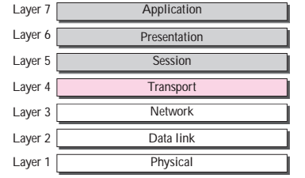
Model OSI (7 layers)

Slide 4
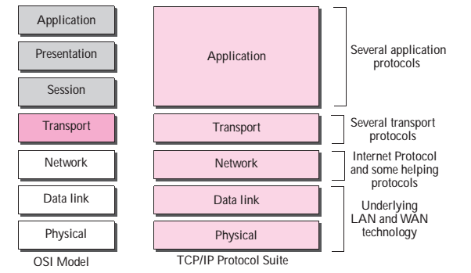
TCP/IP And OSI Model

Slide 5
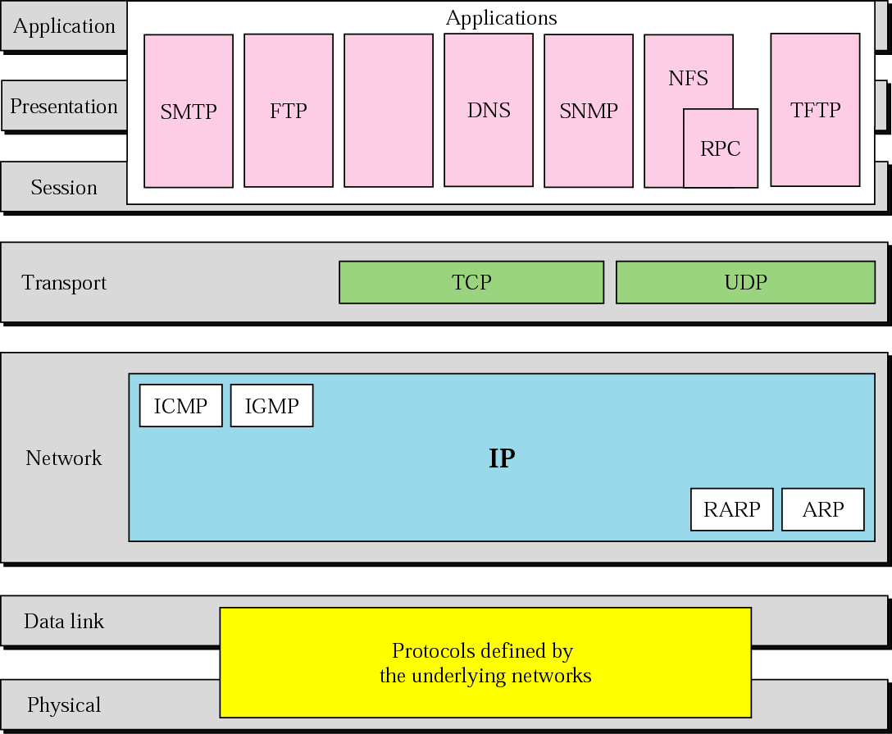
TCP/IP And OSI Model

Slide 6
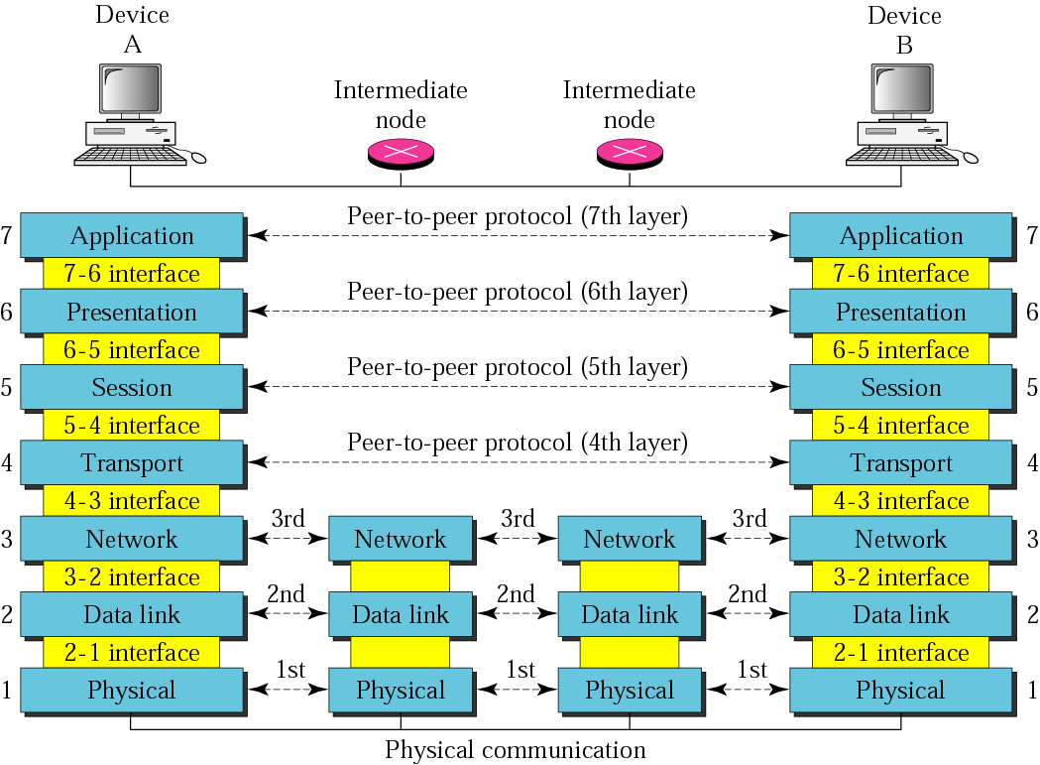
OSI Layers

Slide 7
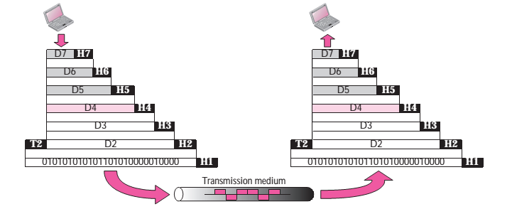
Exchange Using OSI Model

Slide 8
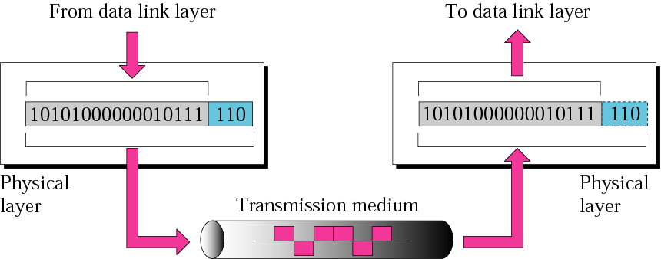
Physical Layer
Physical Layer : Megirimkan bits antar nodes
Unit komunikasi : bit
Notes:
Physical layer concerns: Physical characteristics of interfaces and media, Representation of bits, Data rate, Synchronization of bits, Line configuration, Physical topology, Transmission mode

Slide 9
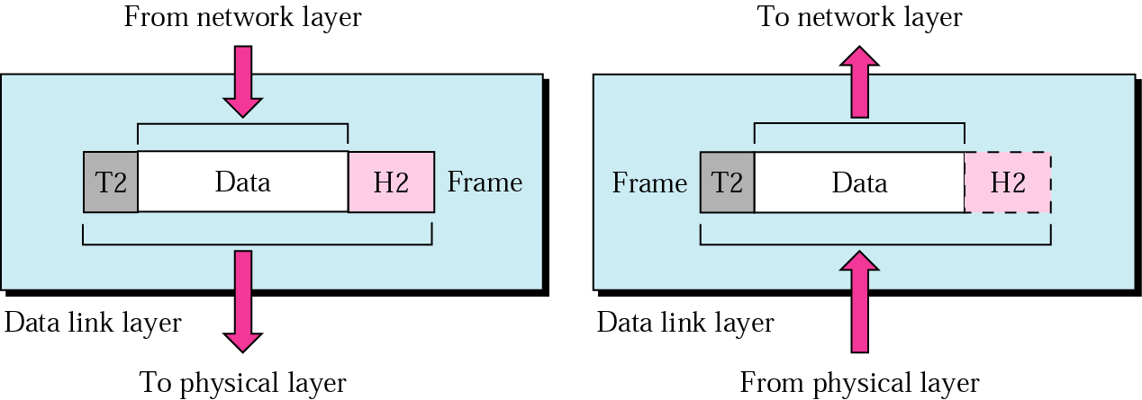
Data Link Layer
Data Link : Mengirimkan frame antar node
Unit komunikasi : frame
Defines frames into manageable data units, Physical addressing, Flow control, Error control, Access control

Slide 10
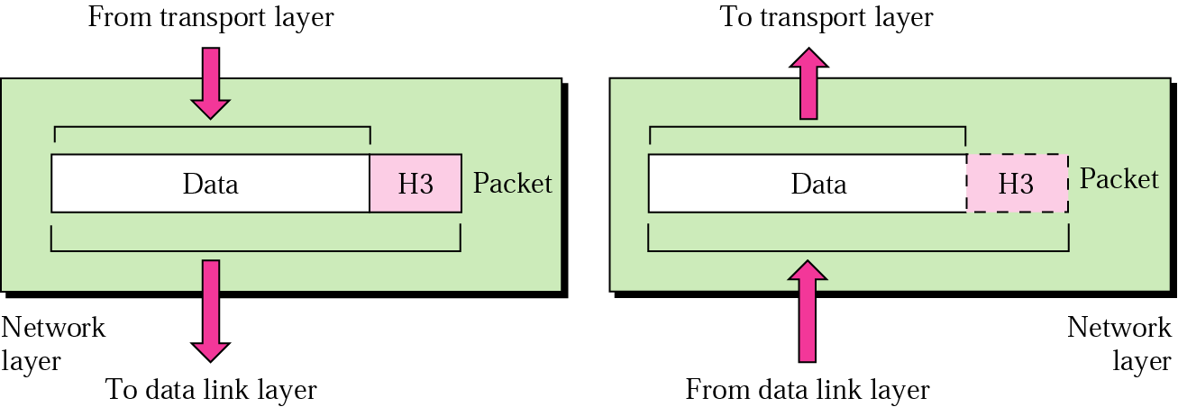
Network Layer
Network Layer : Mengirimkan packet dari original source ke tujuan
Unit komunikasi : packet
Source-to-destination delivery, possibly across multiple networks
Logical addressing
Routing

Slide 11
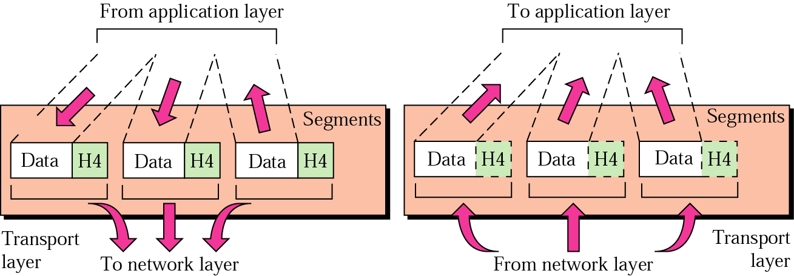
Transport Layer
Transport layer : mengirimkan pesan dari satu proses ke yang lainnya
Process-to-process delivery of entire message
Port addressing
Segmentation and reassembly
Connection control: connectionless or connection-oriented
End-to-end flow control
End-to-end error control

Slide 12
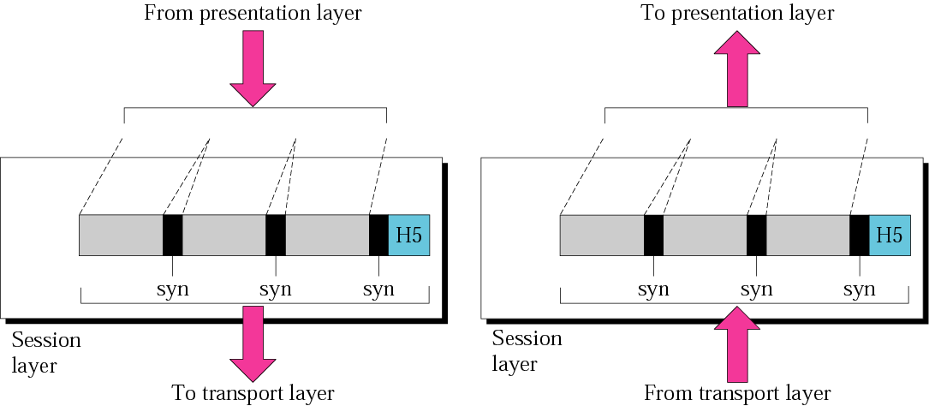
Session Layer
Session Layer : responsible for dialog control and synchronization

Slide 13
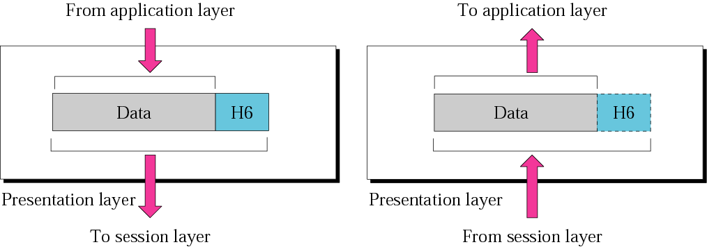
Presentation Layer
Presentation layer is responsible for translation, compression, and encryption.

Slide 14
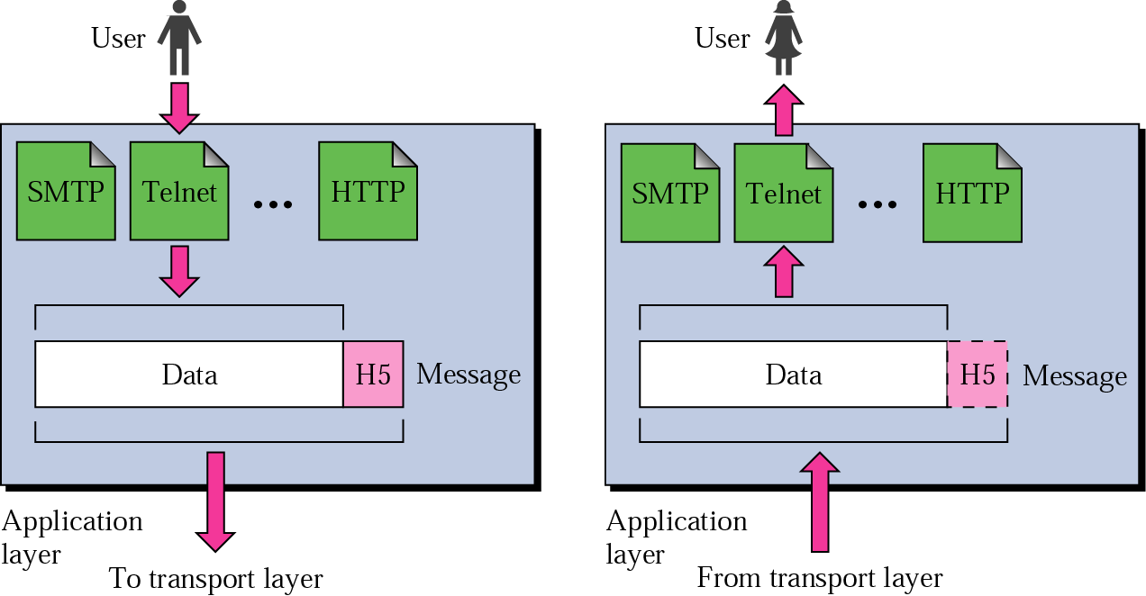
Application Layer
Application Layer : menyediakan layanan ke user
Enables user access to the network
User interfaces and support for services such as
  E-Mail, File transfer and access, Remote log-in, WWW

Slide 15
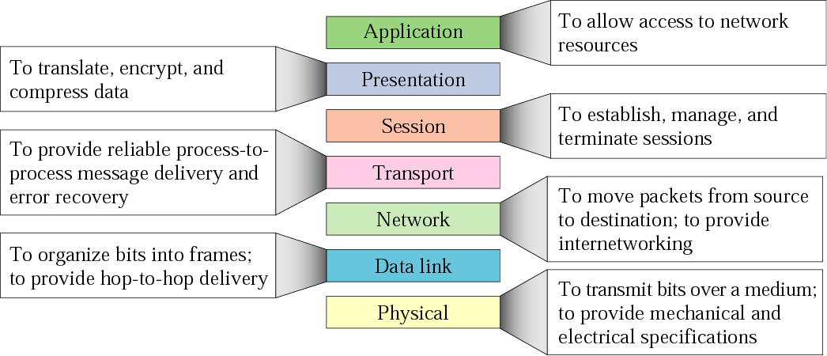
Summary of Layers

Slide 16
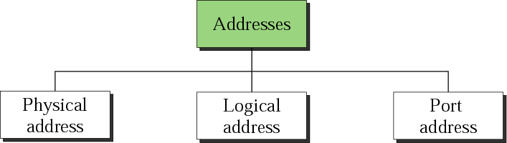
Addressing in TCP/IP

Slide 17
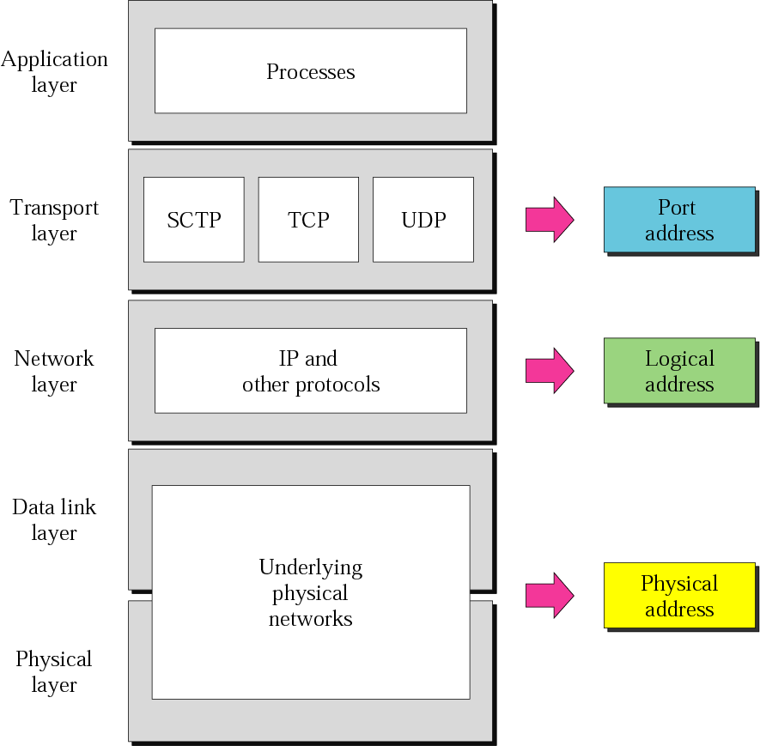
Addressing in TCP/IP

Slide 18
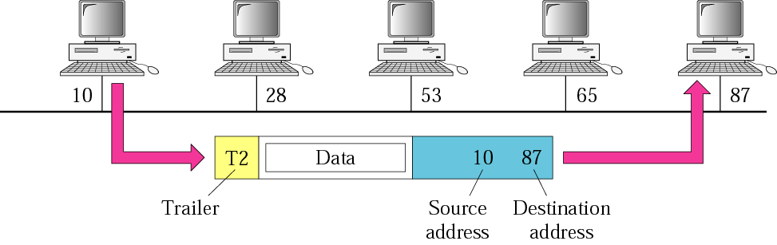
Addressing in TCP/IP : Physical
07:01:02:01:2C:4B
A 6-byte (12 hexadecimal digits) physical address.

Slide 19
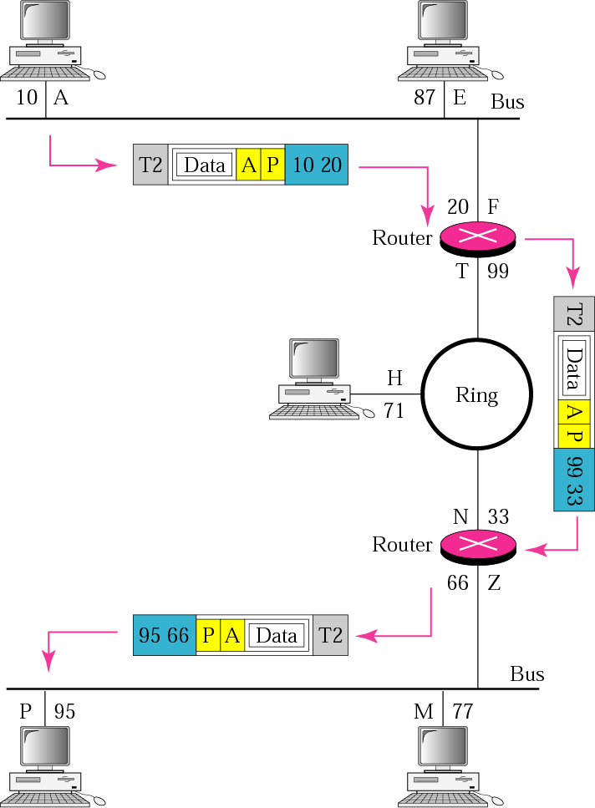
Addressing in TCP/IP : Network
132.24.75.9
An internet address in IPv4 in decimal numbers
80
A 16-bit port address represented as one single number.

Slide 20
Terima Kasih
There is a sky beyond the sky

